Slide 1
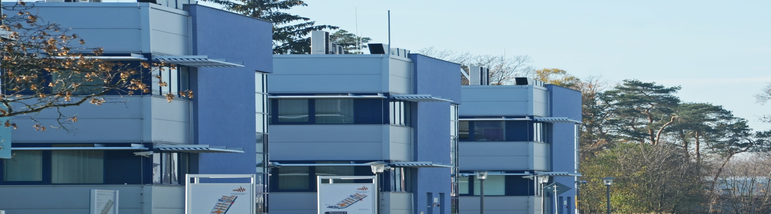
NTC
Simulation Based Desing
Using Human Body Model
March 2019

Slide 2
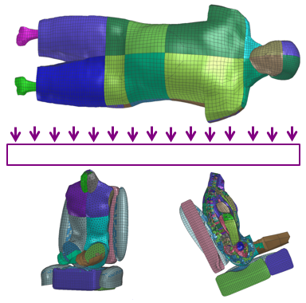
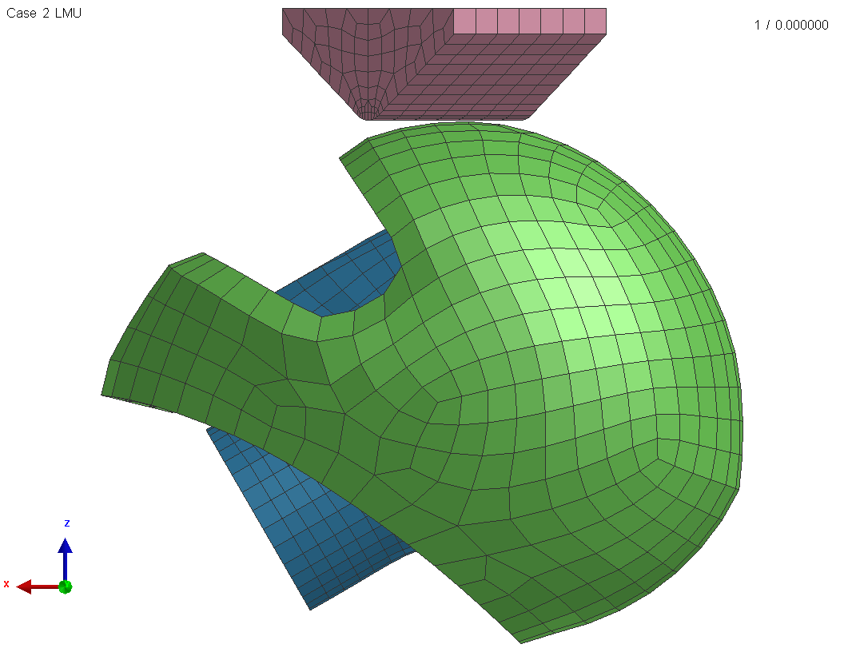
SIMULATION BASED DESIGN
Approach
Multi-disciplinary approach
Combination of design, CAD, calculation and data analysis tools
Student (or a team of students) proposes a functional design
Virtual model to be developed by modelling software
Exporting numerical data for technical analysis
Developing numerical model
Developing numerical model
Running analysis
Analysing results
Conclusions and/or updates on design
Examples
Injury risk assessment
Design change and/or optimization
Design
CAD
Iterative input
Calculation
Analysis

Slide 3
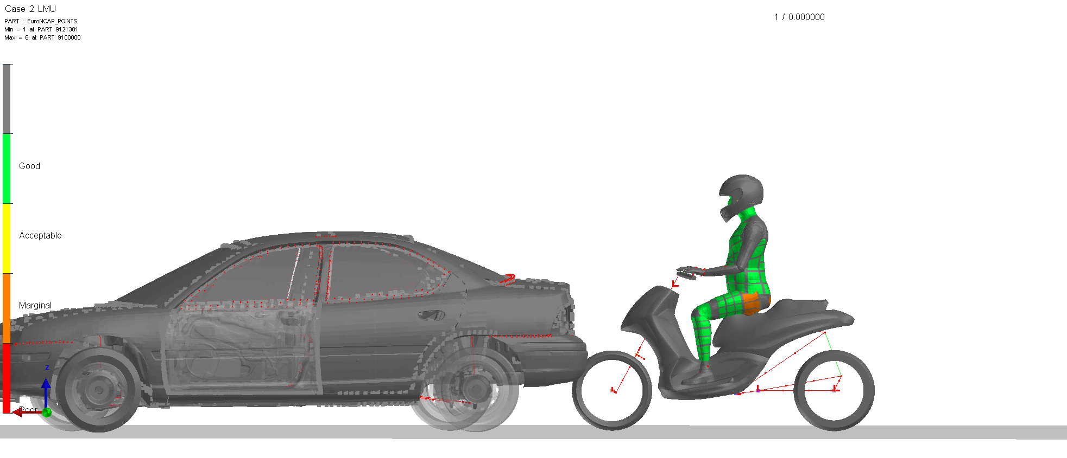
SIMULATION BASED DESIGN
Study programme
Preliminary one-week on-site course at HIT (by UWB experts)
On-site project work at HIT (by HIT students or teams)
Calculation and presentation at UWB (HIT students interacting with UWB experts)
Pre-requisites
What knowledge students have?
STEAM (Science, Technology, Engineering, Art and Mathematics)
Key knowledge level of mathematics and software tools required
Software tools
Design and modelling (design software to be discussed; open platform available)
Exporting and converting data (software to be discussed; open platform available)
Numerical calculation (available at UWB; academic license for 20 users and limited model size for 2 kEUR)
Result analysis (available at UWB; academic license for 20 users and limited model size for 2 kEUR)
Presentation (available in open platform)

Slide 4
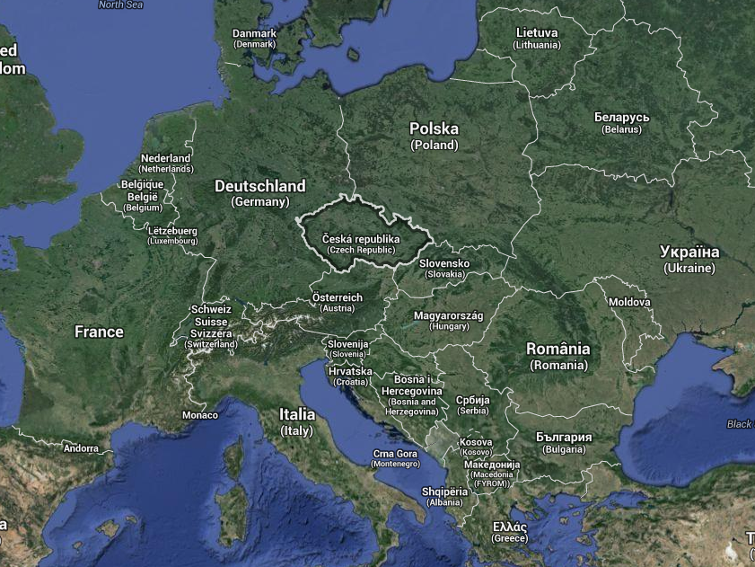
CONTACT
University of West Bohemia New Technologies – Research Centre
Univerzitní 8, 306 14 Pilsen,
Czech Republic
hyncik@ntc.zcu.cz
http://ntc.zcu.cz/en

